Slide 1
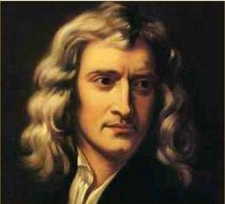
Newton’s Laws
Brought to you by: Sir Isaac Newton and
Laura Akesson (mostly Newton)

Slide 2
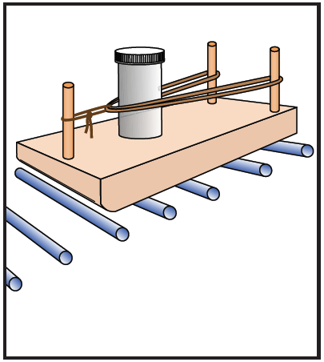
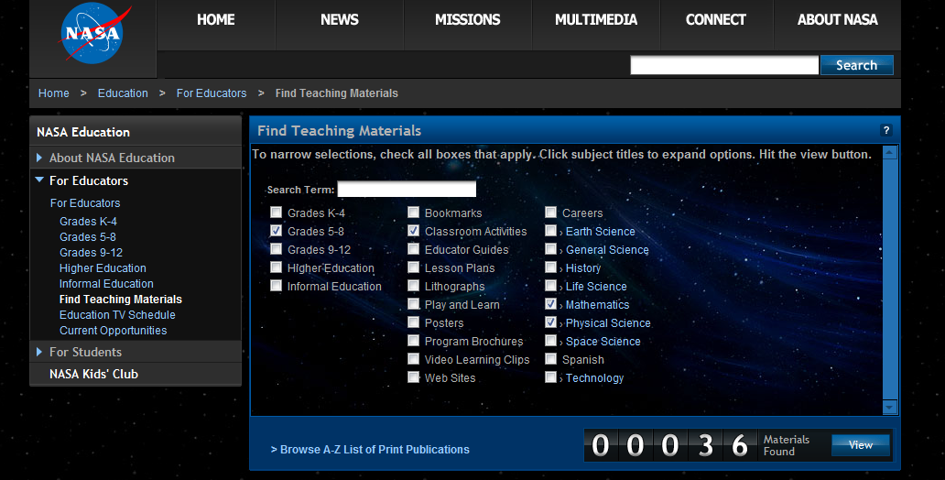
NASA for Educators
nasa.gov
For Educators
Find Teaching Materials

Slide 3
Newton’s First Law of Motion
Inertia.
An object at rest will remain at rest and an object in motion will remain in motion in a straight line at a constant speed unless acted on by an outside force.

Slide 4
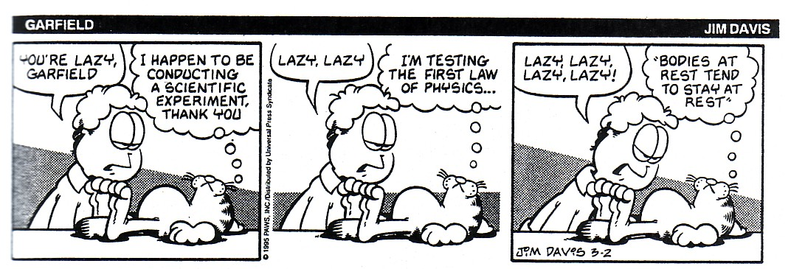
1st Law: Inertia
blood rushes from your head to your feet when riding on a descending elevator which suddenly stops.
the head of a hammer can be tightened onto the wooden handle by banging the bottom of the handle against a hard surface.
a brick is painlessly broken over the hand of a physics teacher by slamming the brick with a hammer. (CAUTION: Do not attempt this at home!)
to dislodge ketchup from the bottom of a ketchup bottle, the bottle is often turned upside down, thrust downward at a high speed and then abruptly halted.
headrests are placed in cars to prevent whiplash injuries during rear-end collisions.
while riding a skateboard (or wagon or bicycle), you fly forward off the board when hitting a curb, a rock or another object which abruptly halts the motion of the skateboard.
When cars turn, there seems to be a force towards the outside. There is no force to the outside!!! Explain.

Slide 5
1st Law: Inertia
About that curve…
As inertial objects, what do Red and Blue want to do?
What will happen to Red during the turn?
What will happen to Blue during the turn?

Slide 6
1st Law: Inertia

Slide 7
1st Law: Inertia

Slide 8
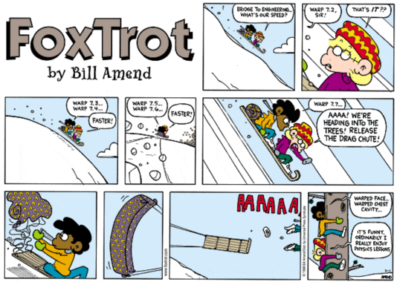

Slide 9
Newton’s Second Law of Motion
F = ma.
(Sum of all forces is equal to the mass times the acceleration).
An object’s acceleration is directly proportional to the sum of all forces on an object, and inversely proportional to the object’s mass.
or
Directly Proportional
Inversely Proportional

Slide 10
2nd Law: ΣF = ma
___ Force ___ acceleration
___ mass ___ acceleration
(Mass constant)
(Force constant)

Slide 11
Newton’s Third Law of Motion
Equal and Opposite Forces.
For any force exerted on object A by object B, there is an equal and opposite force exerted on object B by object A
Gun vs. Bullet
Firefly vs. windshield
F = Ma F = mA

Slide 12
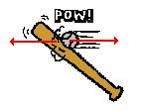
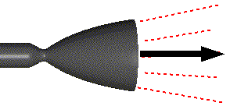
3rd Law: Equal and Opposite Forces
Bat pushes on ball to the right
Ball pushes on bat to the left
Baseball pushes glove leftwards
??
Bowling ball pushes pin leftwards
??
Rocket pushes gas to the right
??

Slide 13
Vocabulary
Inertia- the natural tendency for an object to remain at rest or at constant velocity.
Acceleration (a) – a change in velocity over time (m/s²)
Mass (m)- A quantitative measure of inertia. Units of kilograms (kg)
Force (F)- A push or a pull. Units of Newtons (N)
Net Force (ΣF)- the vector sum of all the forces that are acting on an object. (N)

