Slide 1
Gravity
brought to you by: mass and Laura Akesson

Slide 2
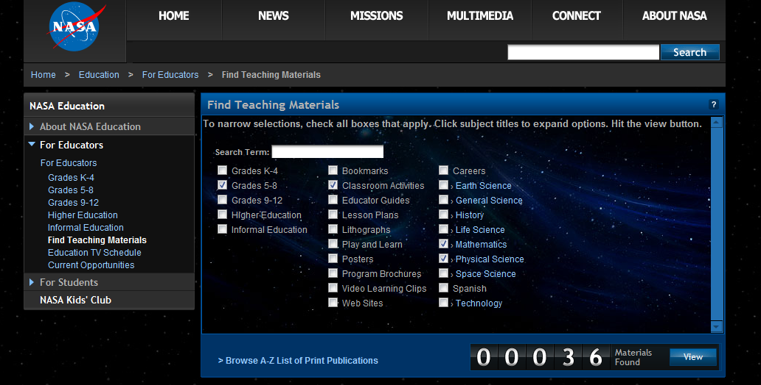
NASA for Educators
nasa.gov
For Educators
Find Teaching Materials

Slide 3
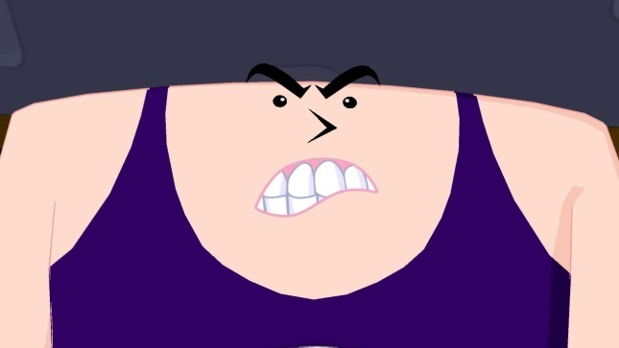
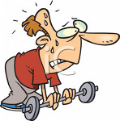
Four Fundamental Forces
Force | Order of Magnitude
Strong | 10⁴⁰
Electromagnetic | 10³⁸
Weak | 10¹⁵
Gravity | 10⁰
10000000000000000000000000000000000000000
100000000000000000000000000000000000000
1000000000000000
1

Slide 4
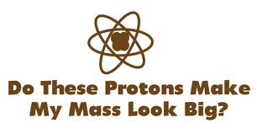
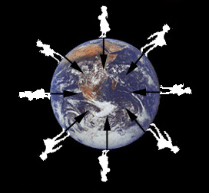
What causes gravity?
MASS
Every piece of matter attracts every other piece of matter
The net force of gravity acts between the center of masses (can be estimated to be the radius of the earth).

Slide 5
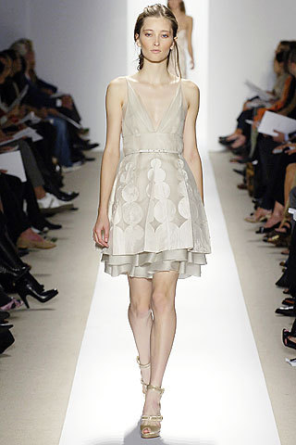
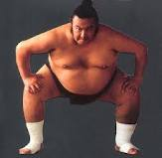
Exactly how attractive am I?
Advanced
NEWTON’S UNIVERSAL LAW OF GRAVITATION
Dude, that guy’s everywhere…
G is the gravitational constant = 6.67 x 10⁻¹¹, m₁ and m₂ are masses in kg, and r is the distance between their centers in meters.
Less attractive
more attractive

Slide 6
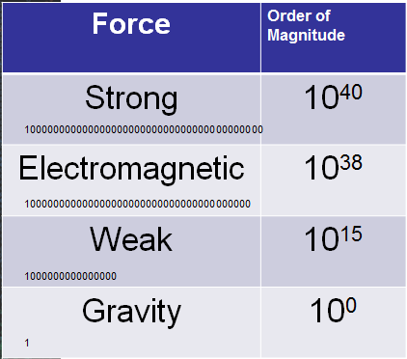
Advanced
Take your mass and your neighbor’s mass in kilograms. Calculate the force of gravity between you. G = 6.67 x 10⁻¹¹
Why are we all not flying towards eachother?

Slide 7
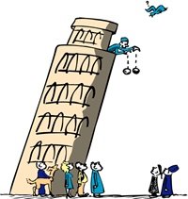
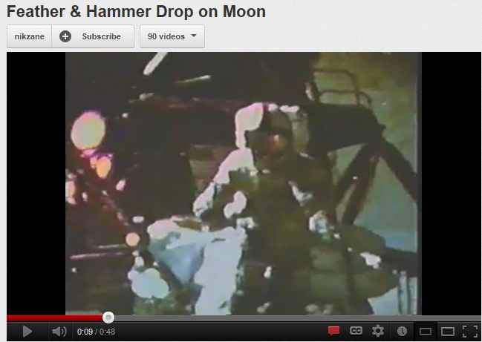
On Earth:
All objects fall at the same rate
g = 9.8 m/s²
Because an object’s inertial mass is equal to its gravitational mass
Ignore air resistance

Slide 8
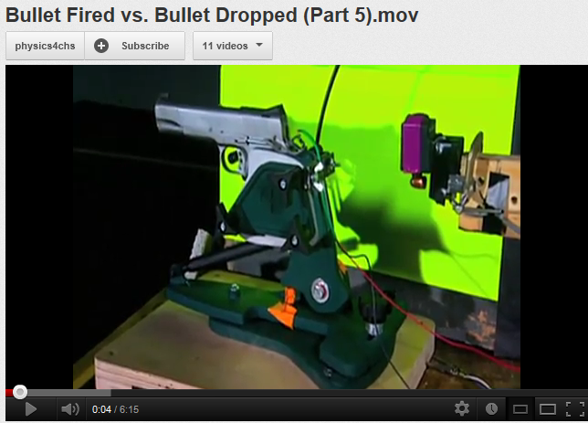
Galileo’s Gedanken Experiment
2 men stand side by side. One fires a bullet horizontally out of a gun at the SAME MOMENT the other man drops a bullet. Which bullet hits the ground first?
Mythbusters:
Part 4 (4 min)
Part 5 (6 min)

Slide 9
CODA

Slide 10
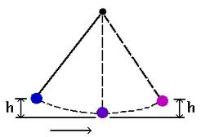
Conservation of Energy
It’s the Law
Energy is neither created nor destroyed.
It is transformed from one form to another.
E_{total} = constant

Slide 11
Mechanical Energy
Gravitational Potential Energy (GPE)
Kinetic Energy (KE)
Elastic Potential Energy
Non-mechanical Energy
Friction (Heat)
Light
Sound

Slide 12
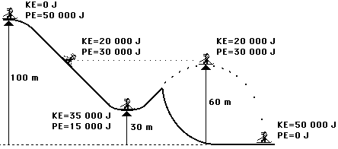
KE and GPE
Energy of motion
Energy of position
UNITS of energy: Joules (J)
E_{total} = constant = 50 000 J

Slide 13
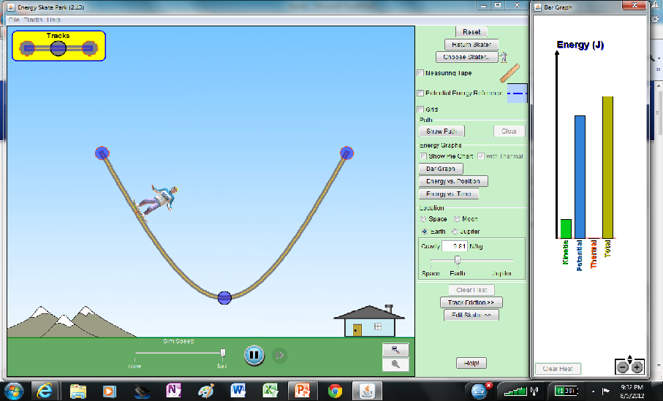
PhET: Energy Skate Park
http://phet.colorado.edu/en/simulation/energy-skate-park

Slide 14
APPENDIX

Slide 15
Inertial vs. Gravitational mass
Advanced
Inertial mass F_{g} = mg
g is the acceleration due to gravity
Gravitational mass
Since G, m_{Earth} and r_{Earth} are constant, g is constant

Slide 16
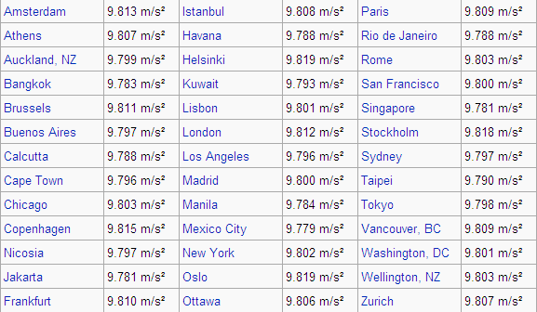
Comparative accelerations due to gravity around the world
Advanced
The table below shows the gravitational acceleration in various cities around the world; amongst these cities, it is lowest in Mexico City (9.779 m/s²) and highest in Oslo and Helsinki (9.819 m/s²).

